Slide 1
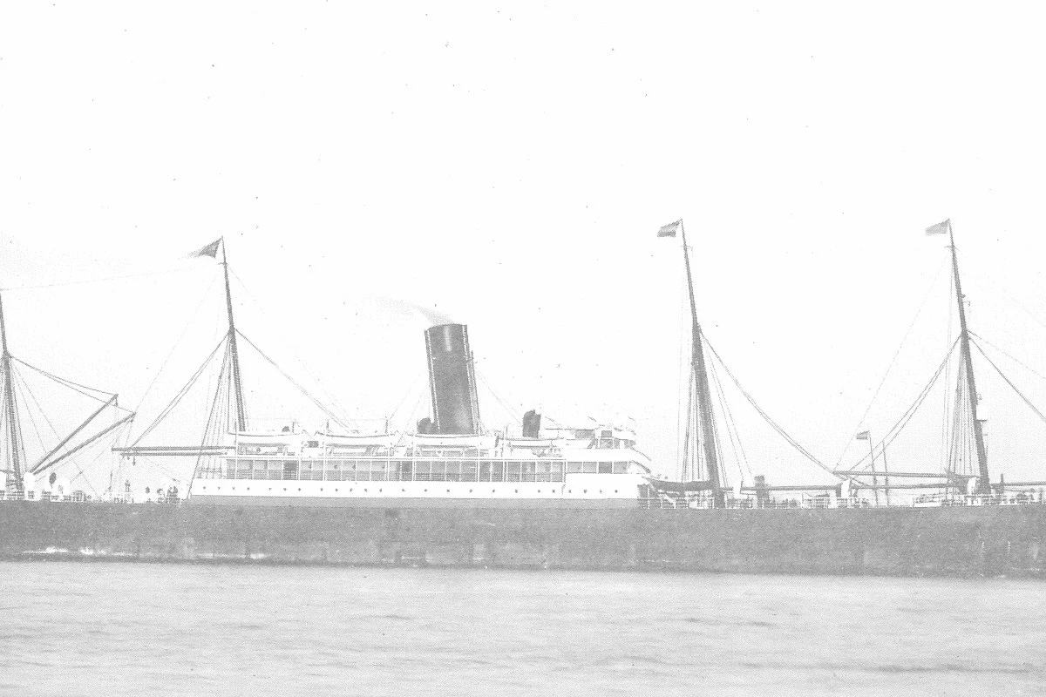


EXPLORATORY DATA ANALYSIS
Source: Titanic Datasets
PRESENTED BY:
Frilantika Kusuma Wardani

Slide 2


Definition of EDA
01 | Import Library
02 | Explore Datasets
03 | Observe Statistical Summary
04 | Data Analysis Visualization
05 | Duplicate Handling
06 | Missing Value Handling
Exploratory data analysis (EDA) is used by data scientists to analyze and investigate data sets and summarize their main characteristics, often employing data visualization methods.

Slide 3

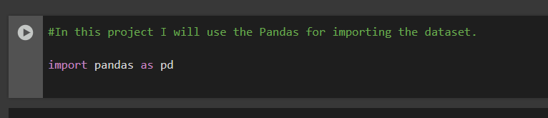
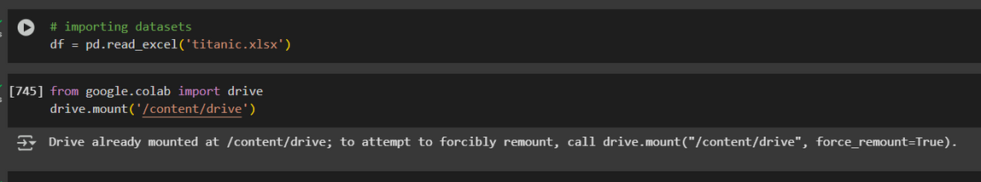
Import Library
Use the Pandas for importing libraries.
Pandas is a Python library used for working with data sets. It has functions for analyzing, cleaning, exploring, and manipulating dataimport pandas as pd
01
Syncorizing google drive with datasets

Slide 4
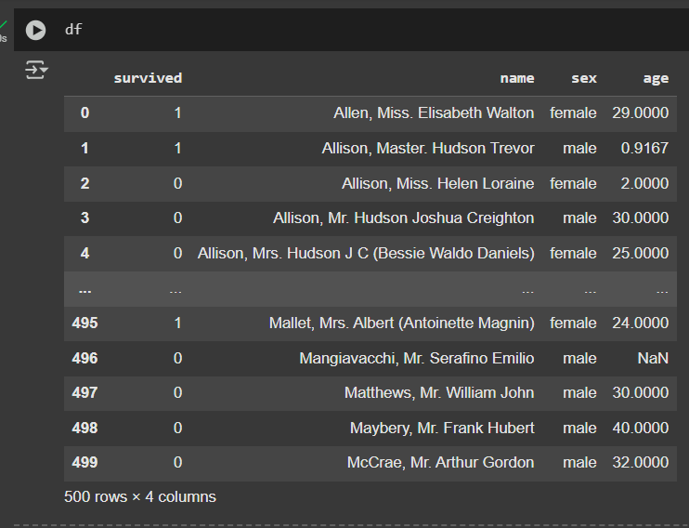
Showing the datasets that has been imported

Slide 5
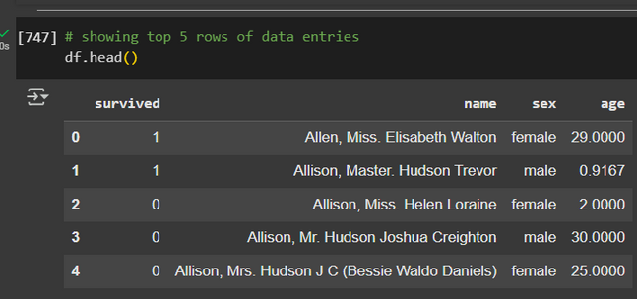
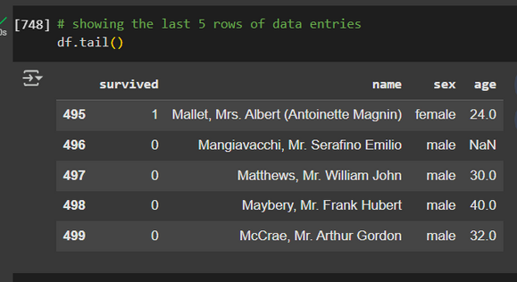
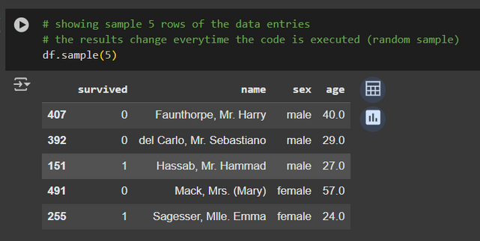
02
Explore datasets with head, tail, and 5 random samples of datasets
Observations:
All columns has complete fromats and appropriately typed
Sex column is categoricals and seems to contain two distinct values (female OR male), but will confirm later
Survived column is numerical type and apparently the binary value (0,1)
No obvious on the data (column name vs its entries), all seems good

Slide 6

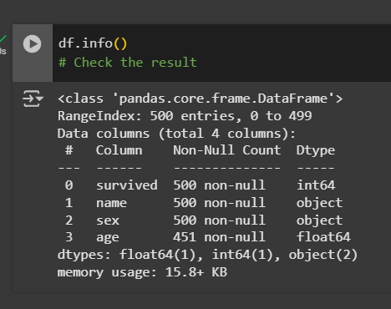
Check the result of exploring datasets
Observation:
Data contains 4 columns with 500 rows
There are 2 columns of categoricals (name and sex) and 2 columns of numericals (survived and age)
Only AGE column have missing values (49 missing data entries), they will be handled later
All dtypes seems OK (appropriate), given the corresponding column name. In order to Sex is naturally object.

Slide 7
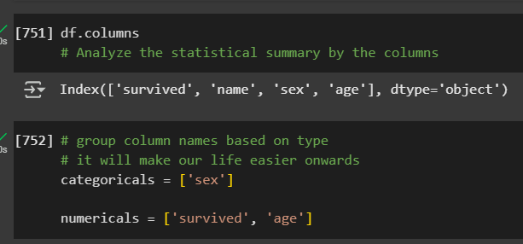
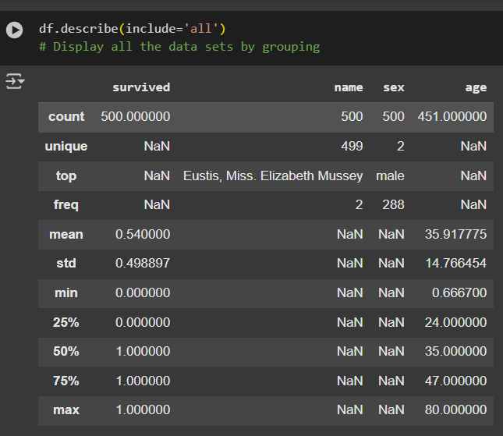
03
Observe the Statistical Summary
Analyze the statistical summary by the columns
group column names based on type
Display the grouping datasets

Slide 8

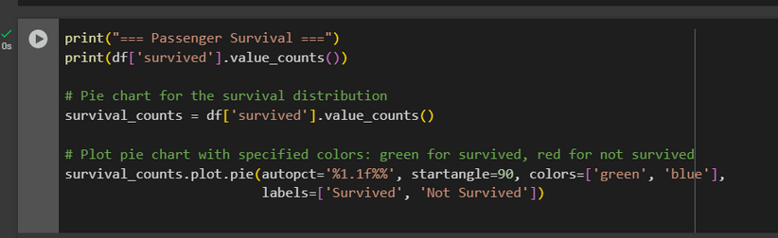
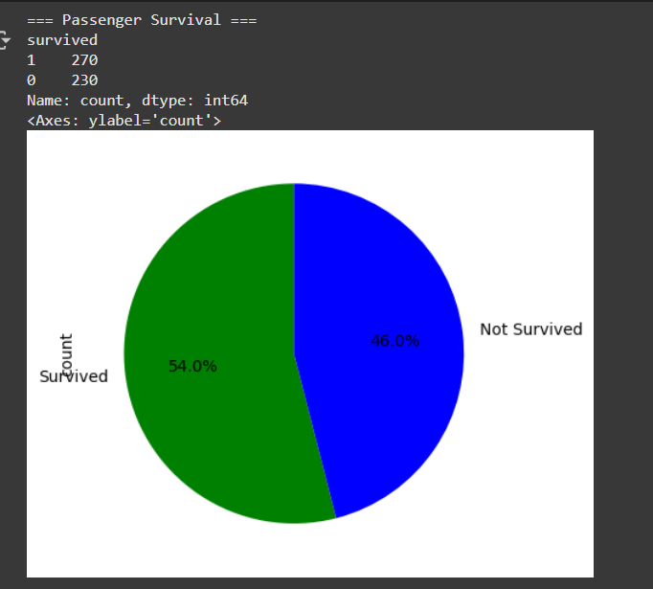
04
Data Analysis Visualization
Observation:
Overall, the minimum and maximum values make sense for each column
Mean~ to 50% (Median) in AGE is somewhat symmetrical distribution (values of variables appear at regular frequencies and often the mean, median, and mode all occur at the same point)
Survived column is boolean/binary column since the values is 1 or 0, no need to conclude its simmetricity. Only need to check balance level

Slide 9

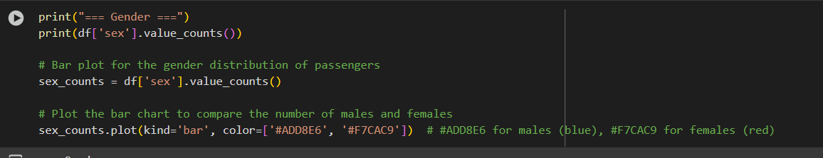
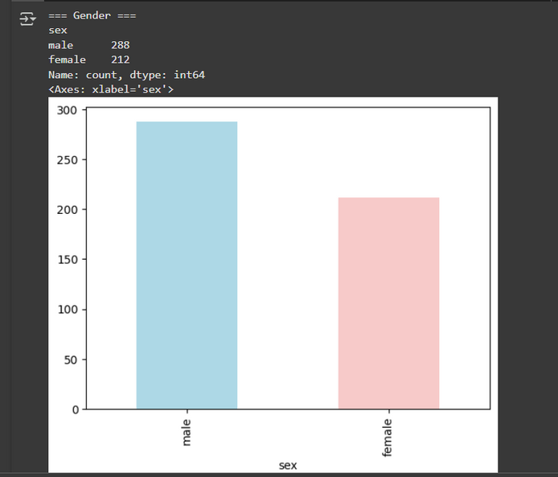
Data Analysis Visualization
Observation:
Sex have 2 unique value, 'male' and 'female'
The most gender of the passenger in Titanic is male (288 rows) and the rest is female

Slide 10
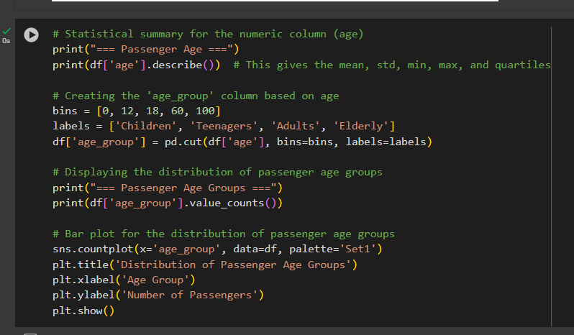
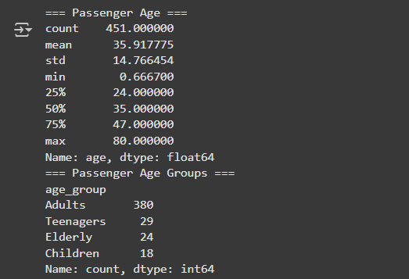
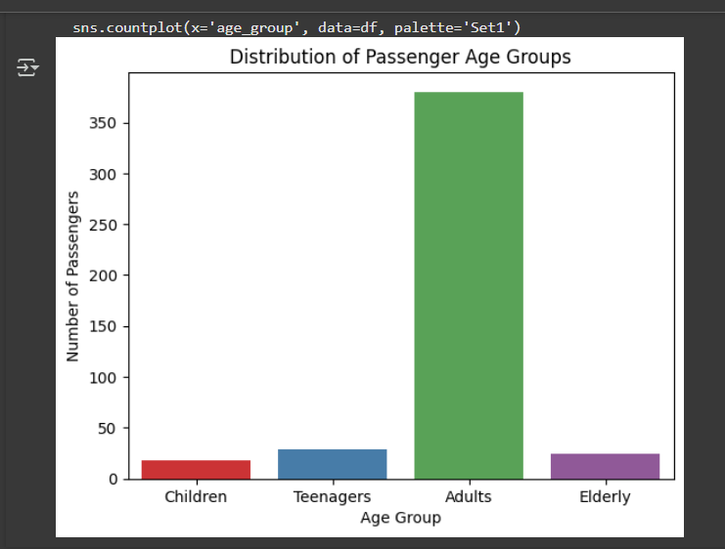
Data Analysis Visualization

Slide 11
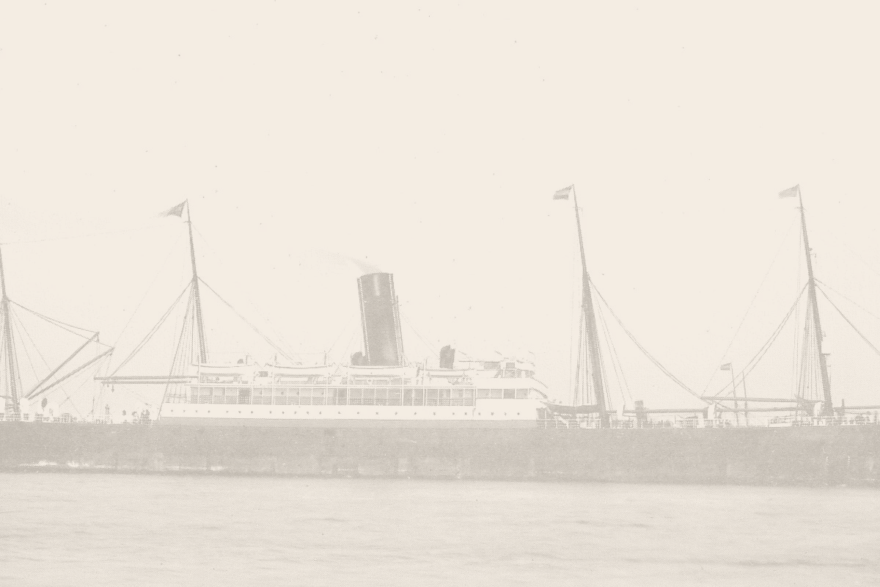
Describe the methods on categorical data by charts
Observation:
Sex have 2 unique value, 'male' and 'female'
The most gender of the passenger in Titanic is male (288 rows) and the rest is female

Slide 12
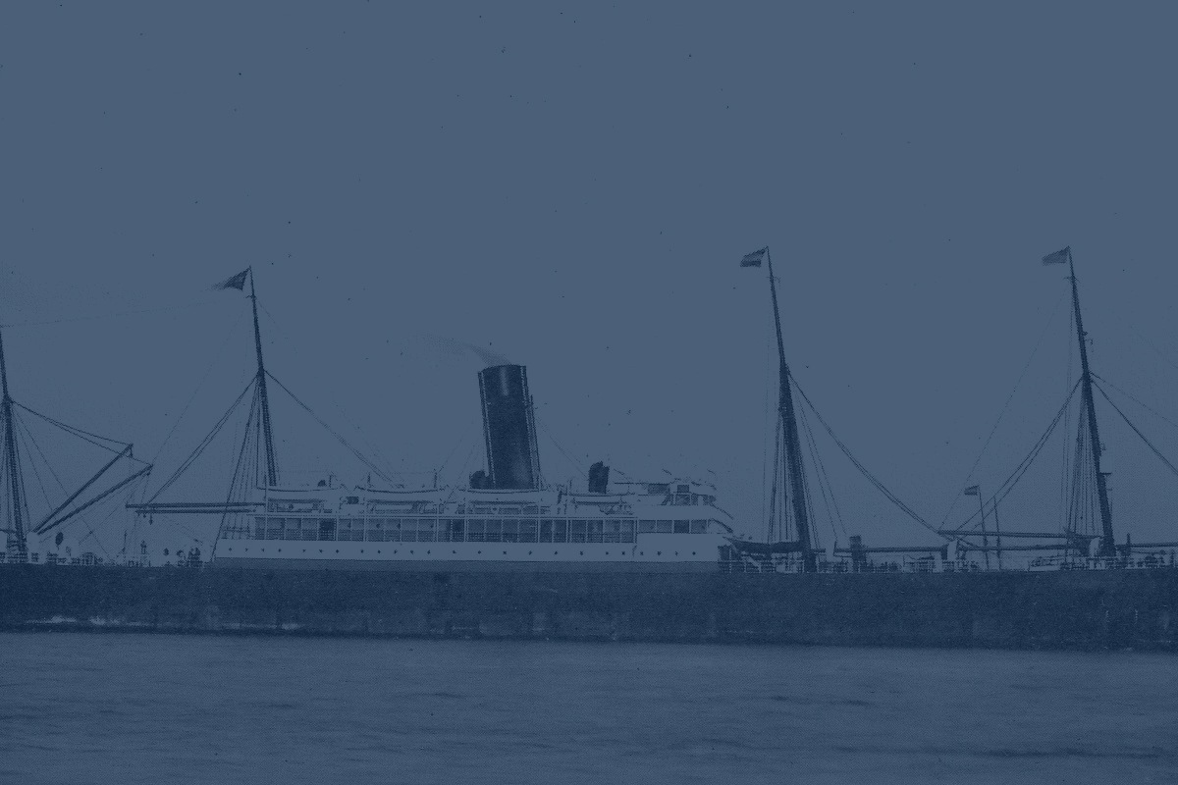
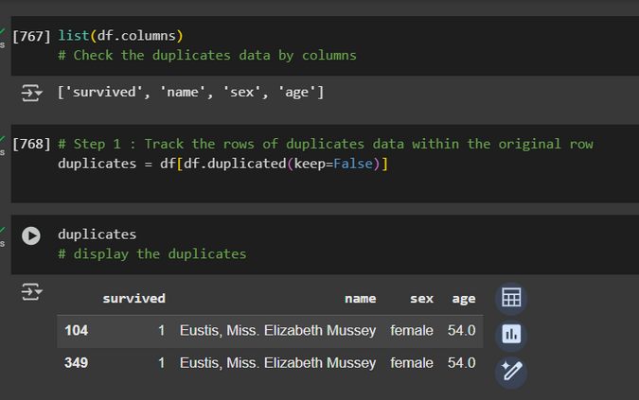
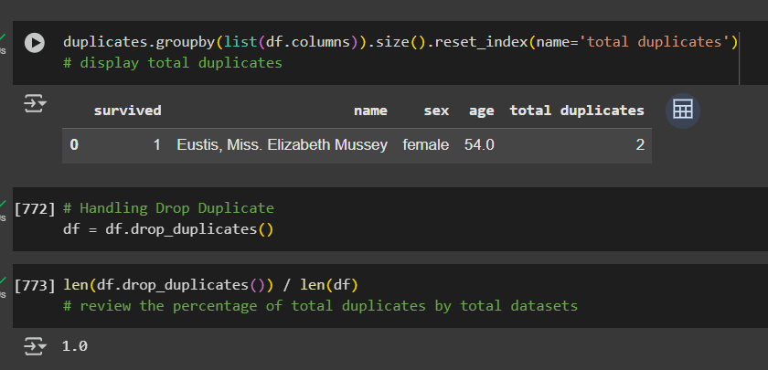

Cleaning Data
Duplicate Handling
Track the duplicate values and show it
Handling the duplicates and counts the percentages
Goal # 1
Elaborate on the first
goal here.

Slide 13
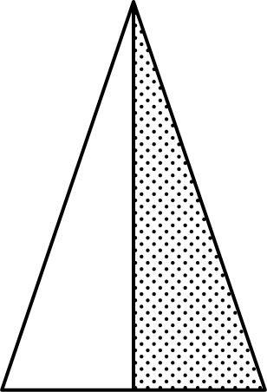
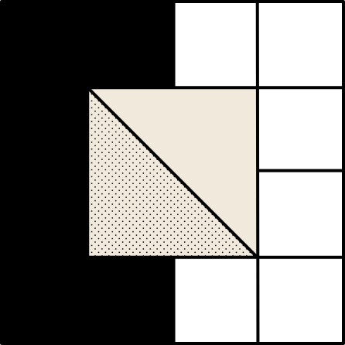
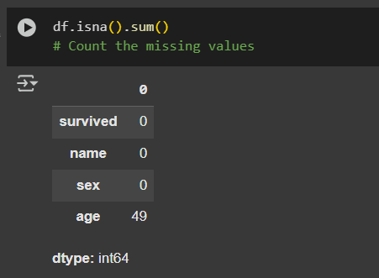
Cleaning Data
2. Missing Value Handling
Identifying the total of missing values
With Python isna() function, we can easily detect the presence of NULL or NA values i.e. missing values in the data set. It is a boolean function that looks for the missing values and returns TRUE where it detects a missing value.
Observation:
Only AGE column has missing values
There has 49 missing data entries of AGE column

Slide 14
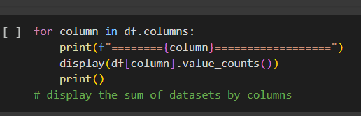
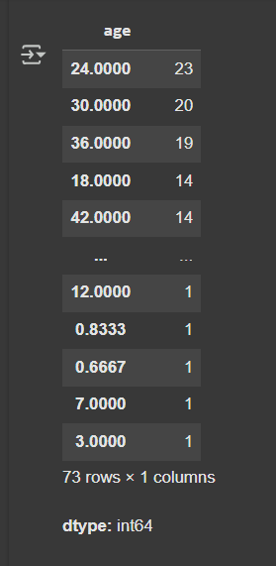
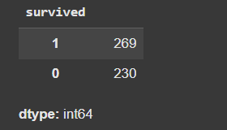
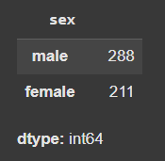
Cleaning Data
2. Missing Value Handling
Identifying the total of missing values by all columns
Observation:
There has 269 survivors and the rest is dead (230)
The most gender of in Titanic is male (288) and the rest is female (211)
The most of the Titanic's passengers AGE in range at 24-30 years old

Slide 15
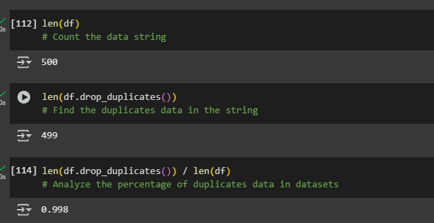
Cleaning Data
2. Missing Value Handling
Check the actual datasets after duplicate handling
Python offers a built-in method to find the length of a list called len() . This method is the most straightforward and common way to determine a list length. The built-in len() function returns the element count as an integer
The len() function in Python is used to get the number of items in an object. It is most commonly used with strings, lists, tuples, dictionaries and other iterable or container types. It returns an integer value representing the length or the number of elements

Slide 16
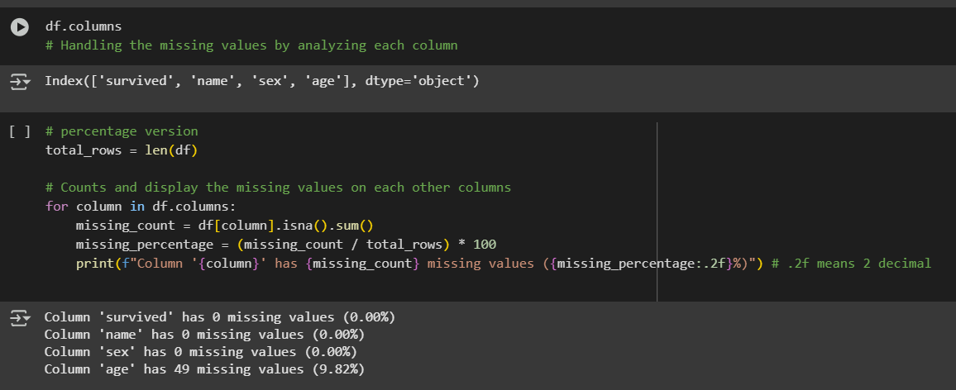
Cleaning Data
2. Missing Value Handling
Handling the missing datasets
The percentage of missing values below 20% so we handle numerically with median, categorical with mode.
But the categorical data type does not have missing values, namely sex.

Slide 17
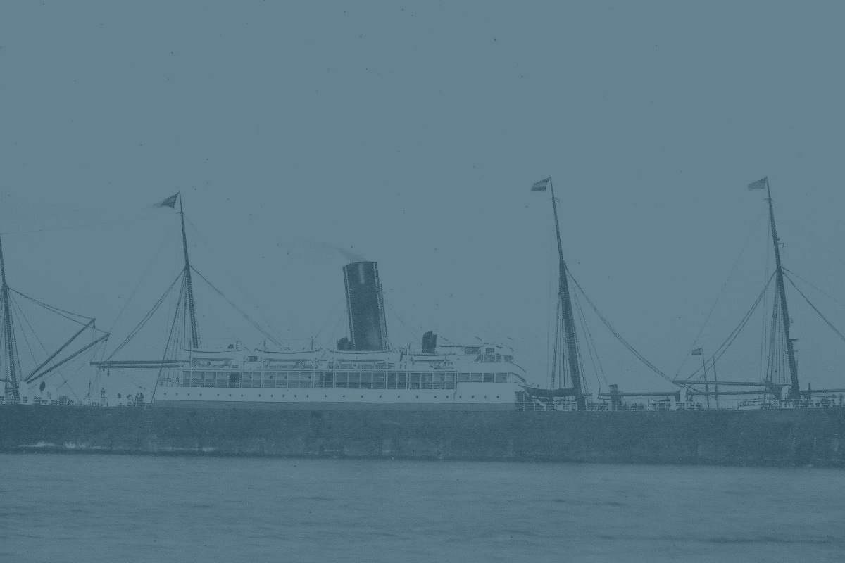
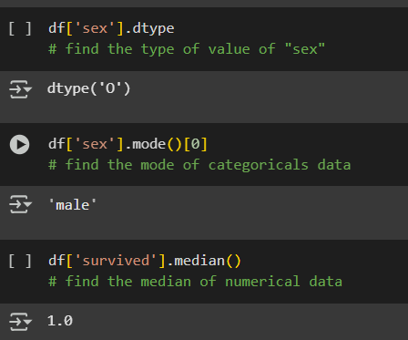
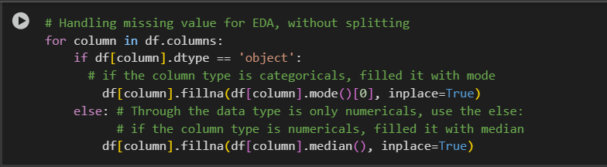
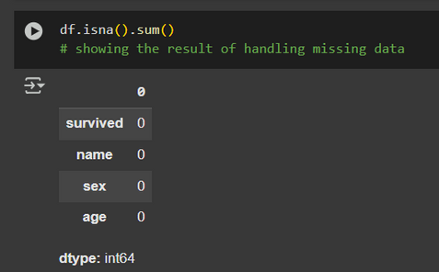
Cleaning Data
2. Missing Value Handling
Handling the missing datasets
Note: The percentage of missing values below 20% so we handle numerically with median, categorical with mode.

Slide 18
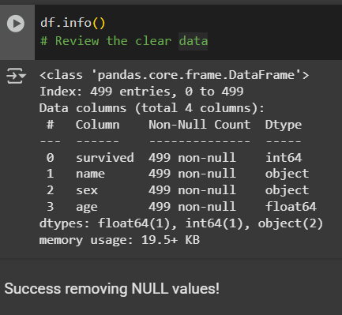
Cleaning Data
2. Missing Value Handling
Handling the missing datasets
Check the result of missing value handling
Results:
Before the process of Cleaning Datasets, there is 500 data entries on Titanic Data Sample, after we conduct the Cleaning data, the result shows 499 data sample.

Slide 19
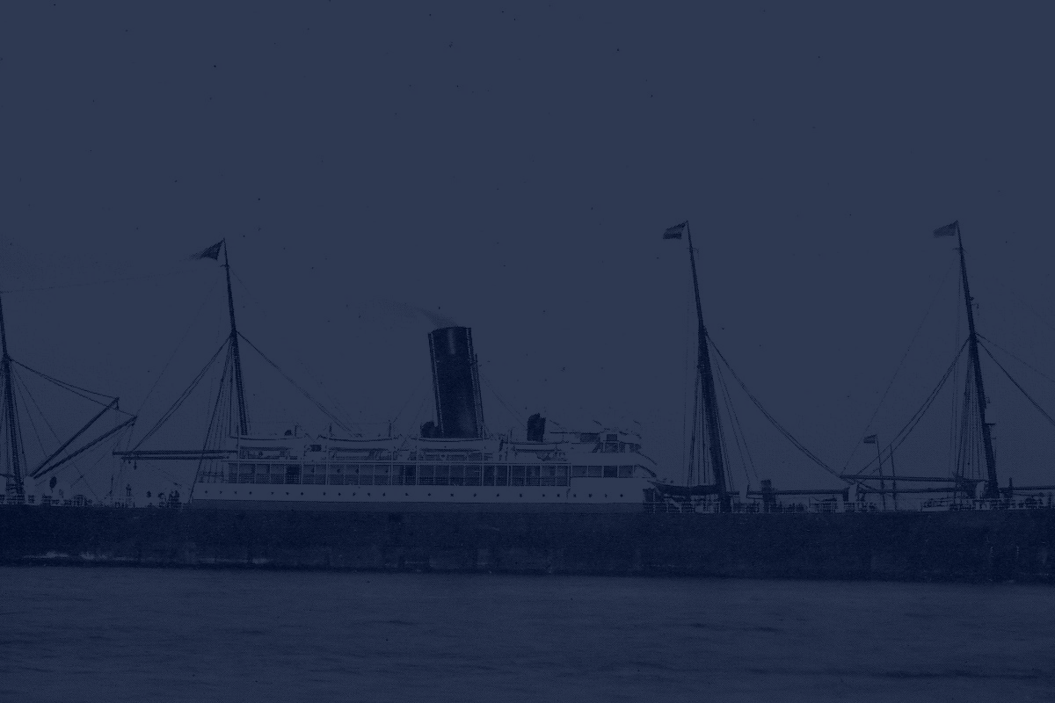
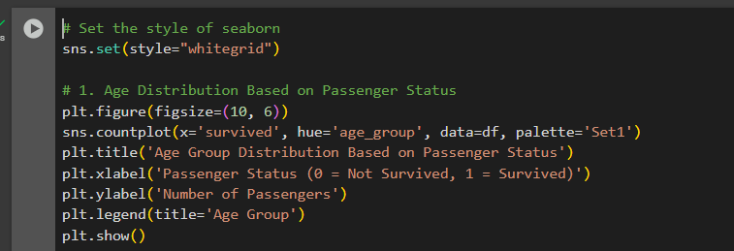
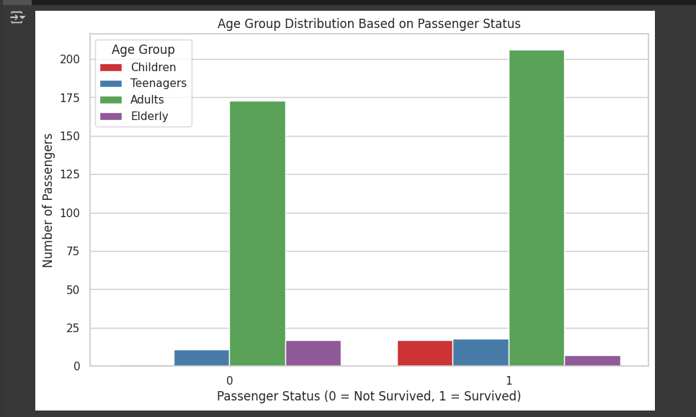
Final Data Analysis Visualization
Here are some potential interpretations that might emerge from the analysis, assuming the visualization aligns with historical accounts:
Children had a higher survival rate: This aligns with the historical accounts where "women and children first" was the priority during evacuation. The visualization might show a significantly higher proportion of surviving children compared to other age groups.
Elderly passengers had a lower survival rate: Older individuals might have faced difficulties during the chaotic evacuation or were less likely to be prioritized for lifeboats. The visualization could reflect this through a lower survival rate for the elderly.
Adults had a mixed survival rate: The survival rate among adults might have varied depending on factors like gender, class, and individual circumstances. The visualization might show both survived and not survived bars with substantial heights for the adult age group.

Slide 20
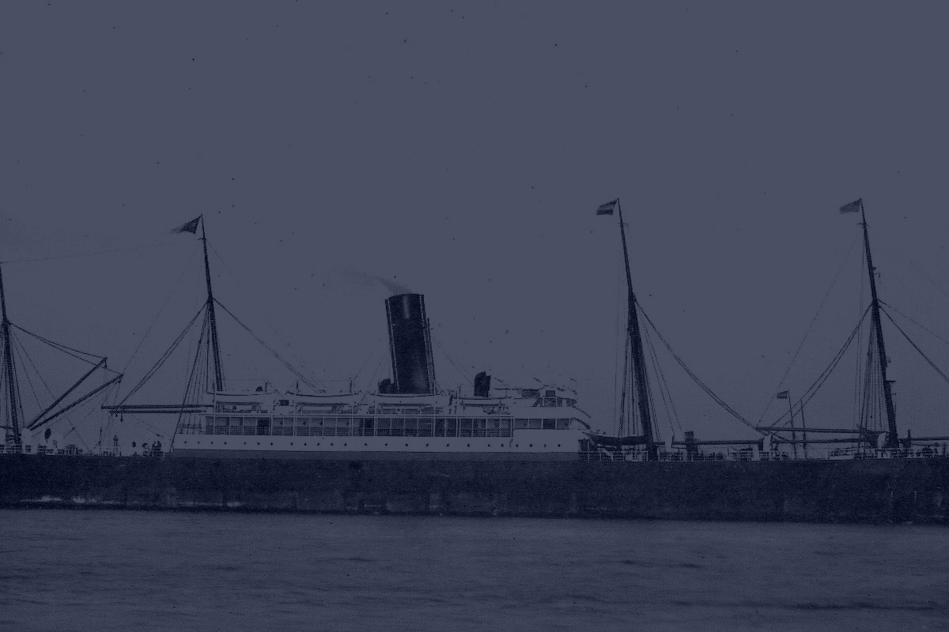
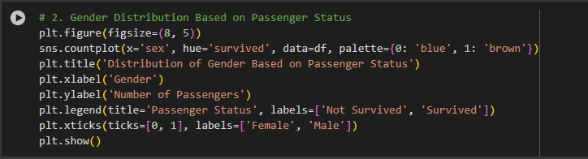
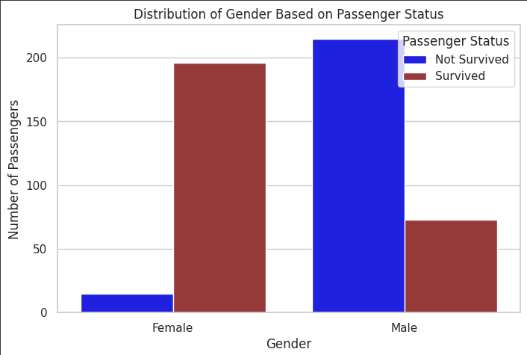
Final Data Analysis Visualization
Females had a significantly higher survival rate: This aligns with the historical accounts where "women and children first" was the priority during evacuation. The visualization might show a substantially higher proportion of surviving females compared to males.
Males had a lower survival rate: A larger proportion of males might have perished in the disaster due to factors like limited lifeboat space and the prioritization of women and children. The visualization could reflect this through a lower survival rate for males.

Slide 21
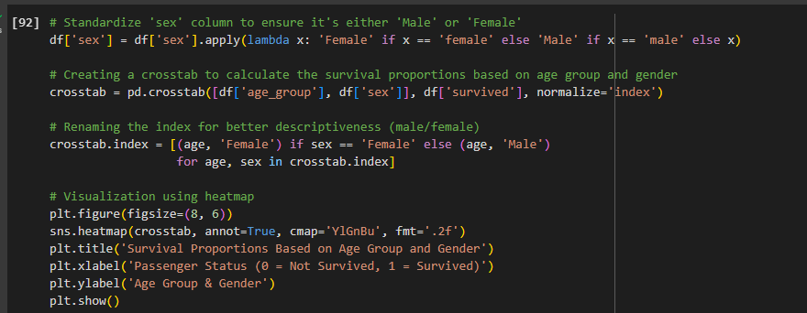
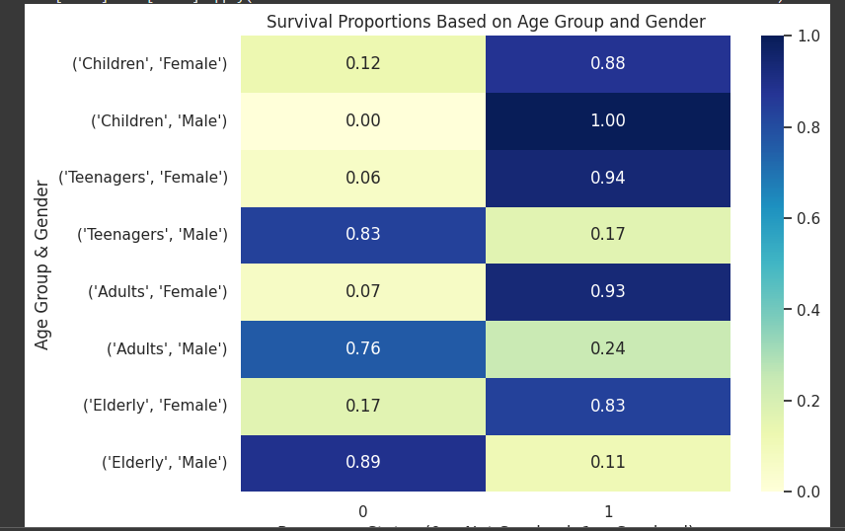
Final Data Analysis Visualization
Female passengers, especially children and adults, had higher survival proportions: This aligns with the "women and children first" protocol during evacuation. The heatmap might show darker colors and higher annotations for cells representing females in various age groups.
Male passengers, especially adults, had lower survival proportions: Males, particularly adults, might have faced lower survival chances due to limited lifeboat space and prioritization of women and children. The heatmap could reflect this through lighter colors and lower annotations for cells representing males.
Age played a role within gender: While females generally had higher survival rates, there might be variations within age groups. For example, female children might have had slightly higher survival proportions than adult females.

Slide 22
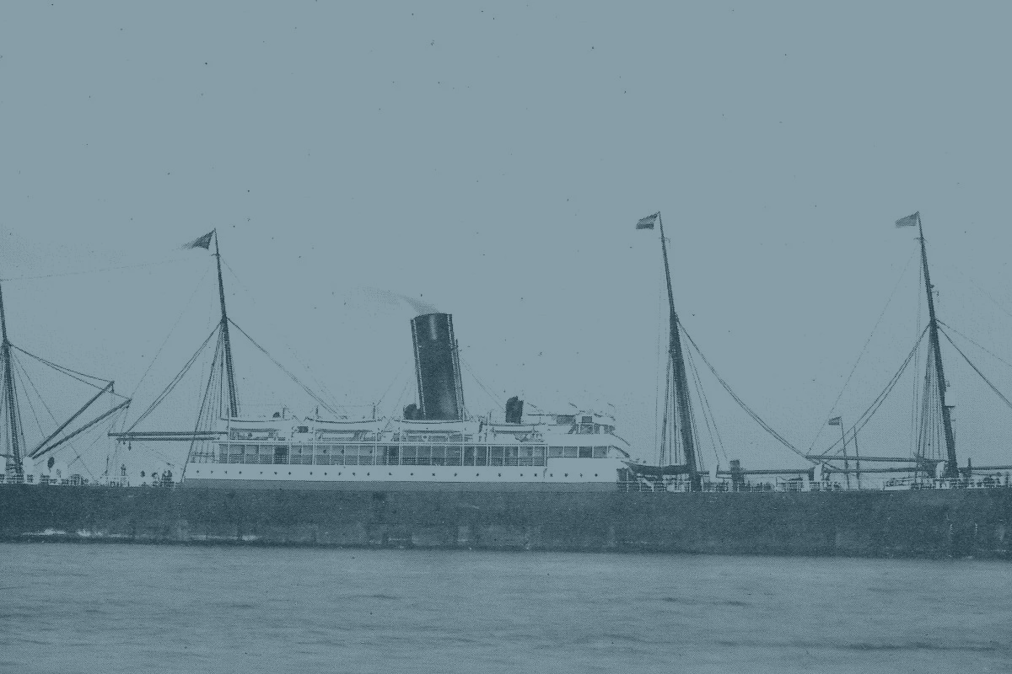
This is the end of the session.
Thank you !

